Slide 1

Advanced Tracking System for Crystal Physics
Stefano Carsi (736512)
Master Degree in Physics
Department of Science and High
Technology (Como)
March 19th, 2024
Supervisor: Prof.ssa Michela Prest
Co-supervisor: Dr. Erik Vallazza

Slide 2
Overview
What crystals and directional effects are
Channelling in straight and bent crystals
The GALORE and e+BOOST projects
The INSULAB Test System
Upgrading the test system to match the experiments requirements
Laboratory and on beam characterization of the upgraded system
Preliminary beamtests results of the two experiments

Slide 3
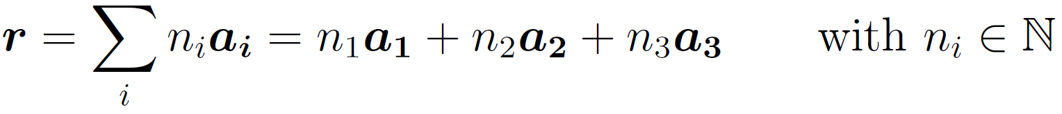
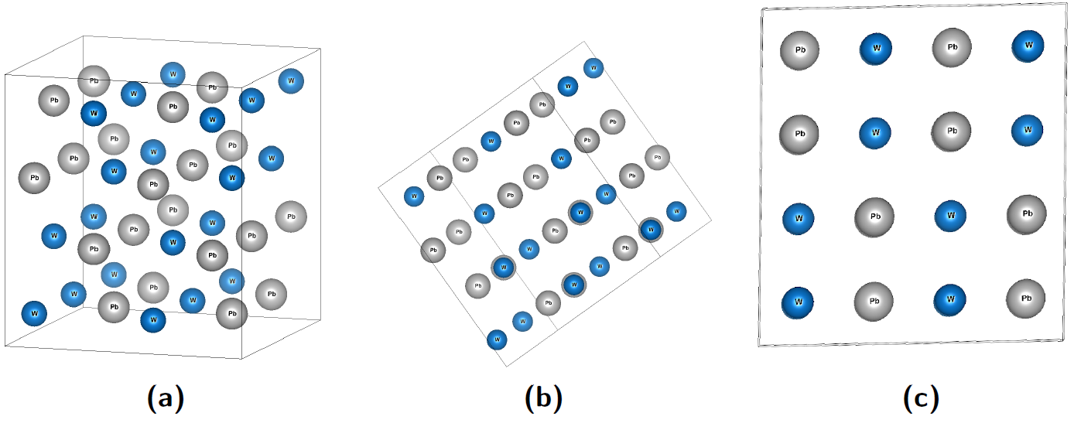
What are crystals?
Materials in which their microscopic constituents (either atoms, molecules or ions) are arranged in a highly ordered microscopic structure, forming a crystal lattice that extends in all directions
Depending on the relative orientation with an observer, the crystal may or may not show its ordered structure
Non oriented
Planar
Axial
3

Slide 4
What is Channelling?
Stark (1912) predicted the existence of “easy passages” along “open channels” in crystal lattice
Lindhard (1964): theoretical description of the phenomenon
The interaction of an impinging particle with the crystal atoms/ions is described with a screened Coulomb potential of the whole crystal lattice
Two types of channelling: axial and planar
A particle is trapped in a potential well and forced to propagate oscillating within the potential well itself
4

Slide 5
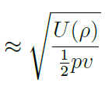
Channelling in bent crystals
Critical angle: angular acceptance for
channelling phenomenon (2) to happen
If a crystal is bent along the direction of motion, the net effect for a channelled particle is a deflection of its trajectory
Other phenomena: Dechannelling (3), Volume Reflection (4), Volume Capture (5)
5

Slide 6



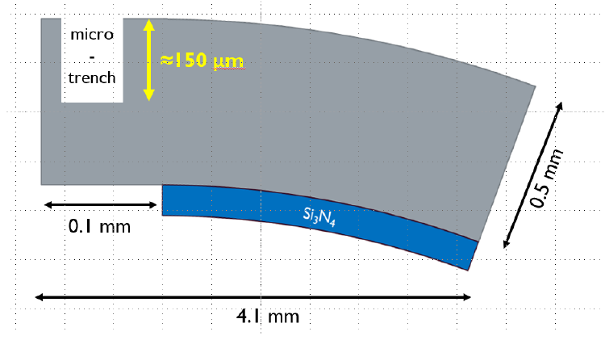
GALORE
Project funded by INFN (Istituto Nazionale di Fisica Nucleare)
Development of a new generation of bent crystals
Goal: increase channelling efficiency up to ~100%
Idea: the insertion of a lattice interruption at the very beginning of the crystal should act as a focusing lens
Channelling efficiency: percentage of the particles which impinge within the crytical angle and maintain the channelling condition along the whole crystal
Sketch of the crystal in the XZ plane
6
BEAM

Slide 7
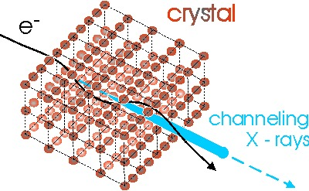
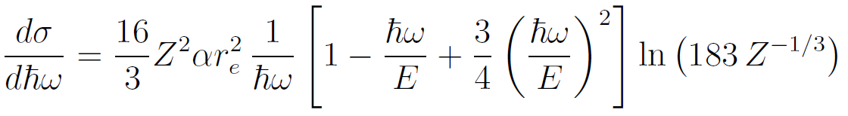
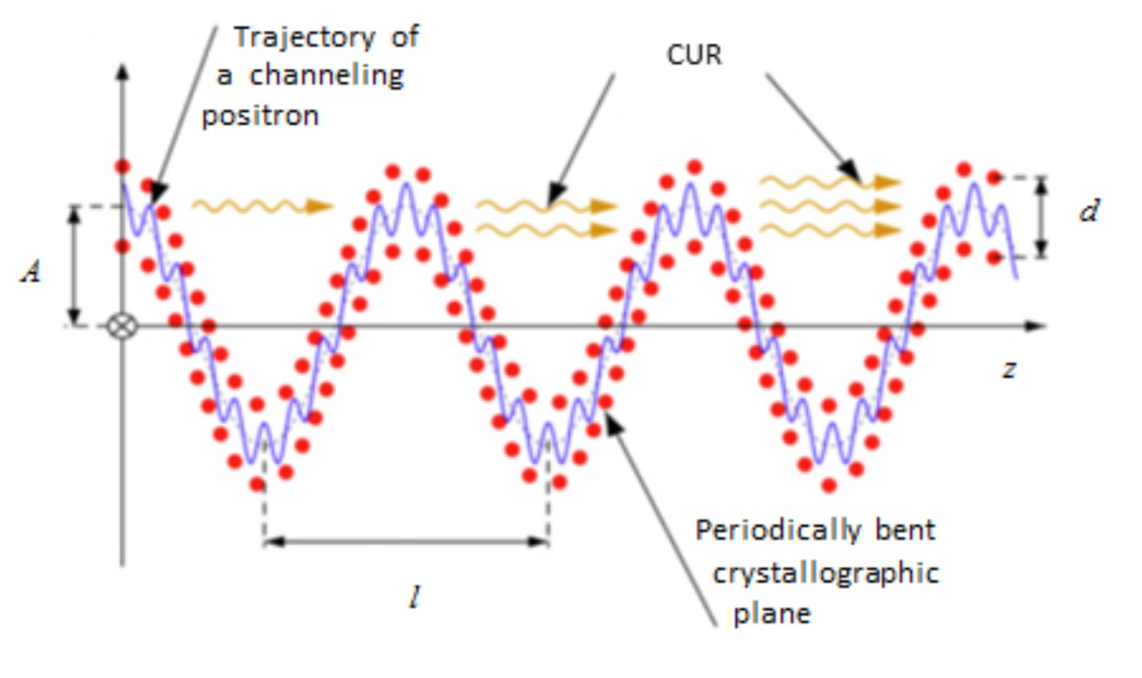
Radiation production
An accelerated charged particle emits radiation
For electrons, by using a quantum model → Bethe-Heitler approximation for bremsstrahlung
Coherent bremsstrahlung: increase in the radiation production by an electron which scatters coherently on many atoms along its way inside an oriented crystal
7

Slide 8
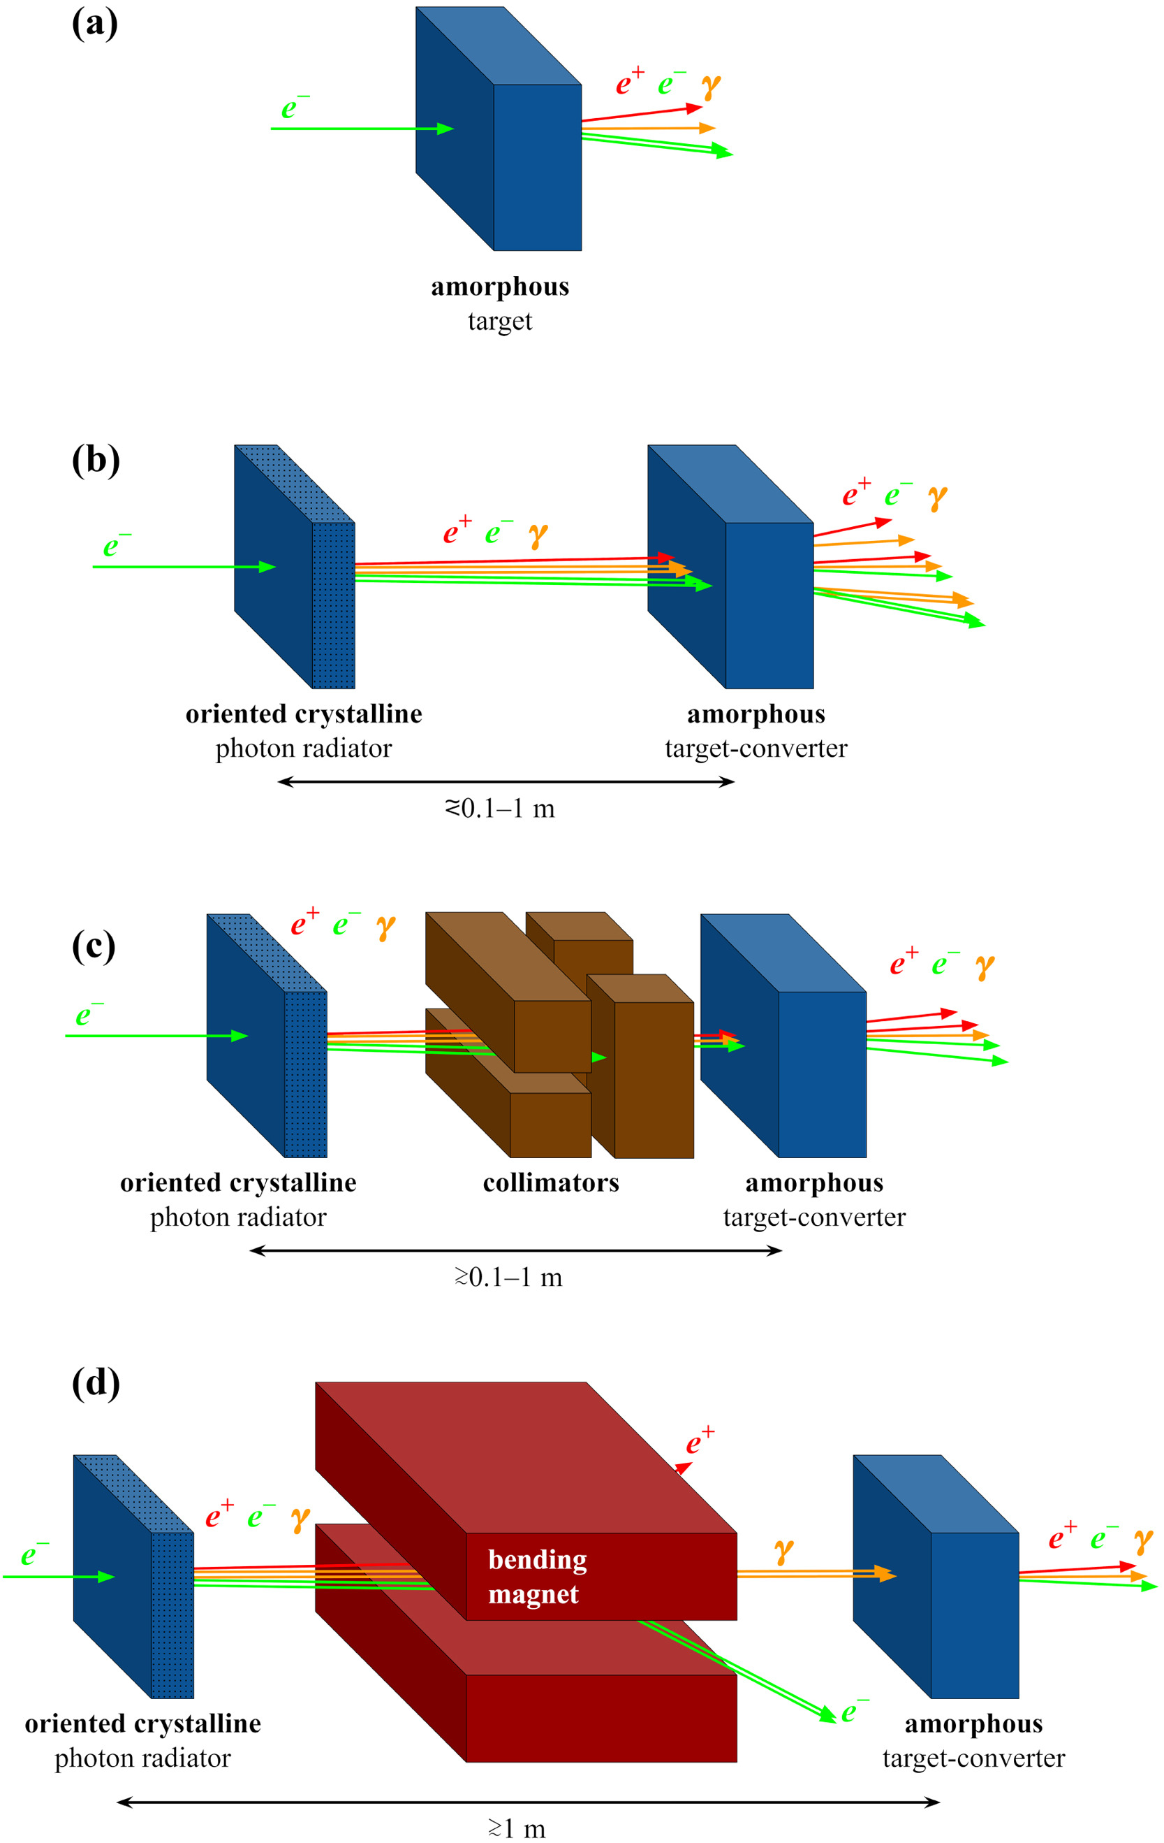
A crystal-based hybrid positron source
Positron source: key element for future particle colliders
Conventional approach: electron beam on high-density and high-Z target
Hybrid design: oriented crystal for producing photons which can convert into electron-positron pairs inside an amorphous converter
Collimator or bending magnets may improve the performance
e+BOOST project
  Funded by the Italian University and Research Minister as PRIN (Progetti di Rilevante Interesse Nazionale)
  Goal: test different crystal radiators
8

Slide 9
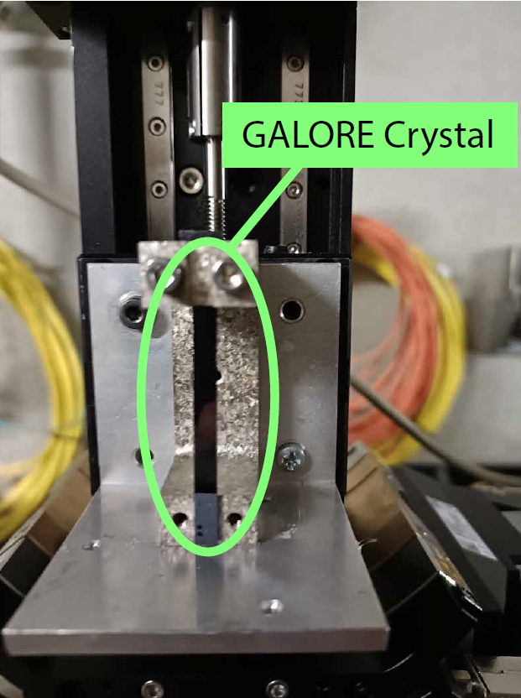
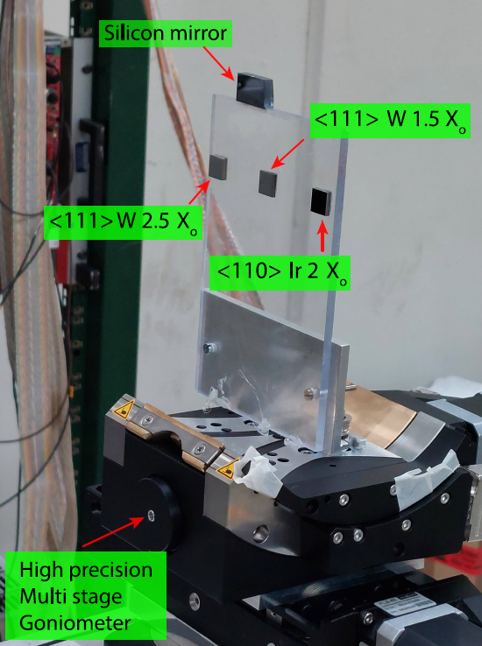
Two projects, same requirements
The GALORE and e+BOOST projects require
High-resolution particle tracking
Particle beams with small profiles and small angular divergence
However, as the beam size is reduced, the angular divergence increases
Need to select only a small portion of the beam to acquire a large enough statistics
This thesis work focused on the upgrade of the electronics to allow for the collection of the required statistics in a limited time
9

Slide 10
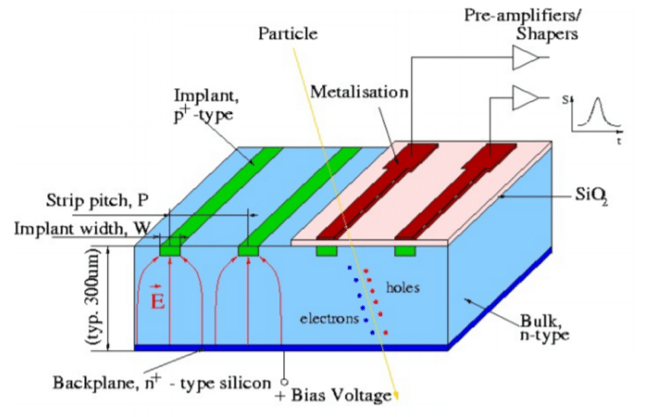
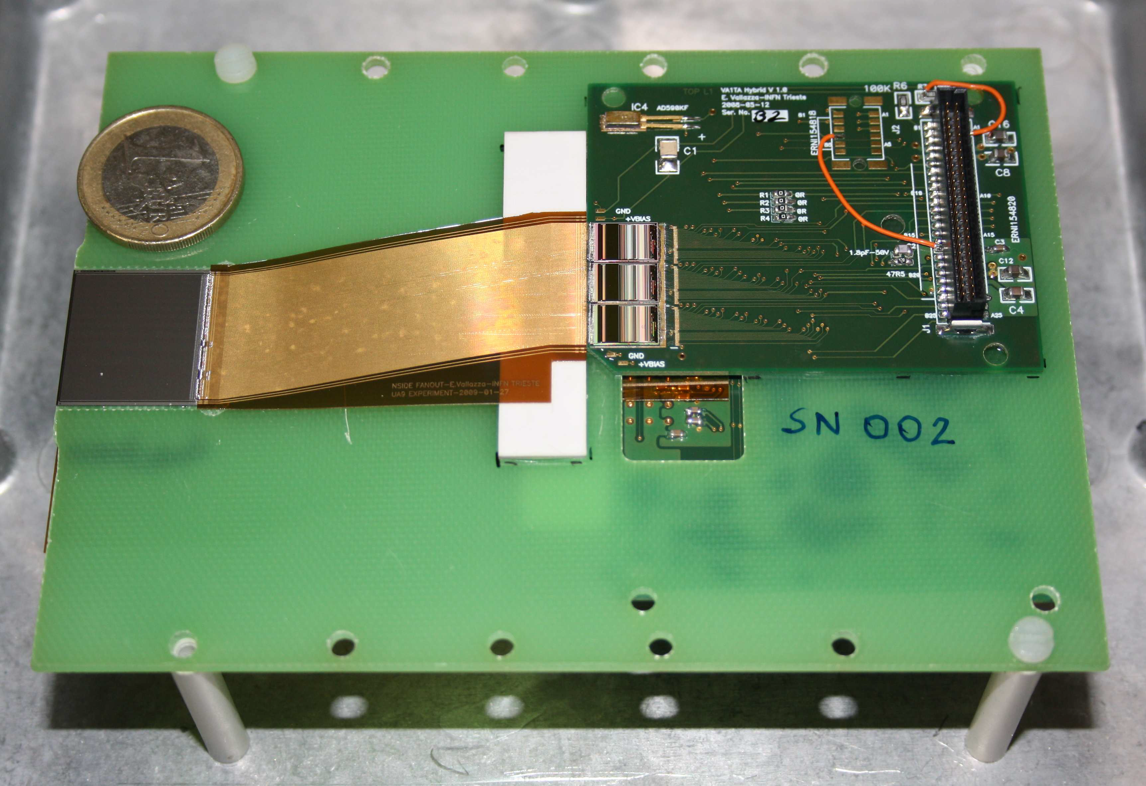
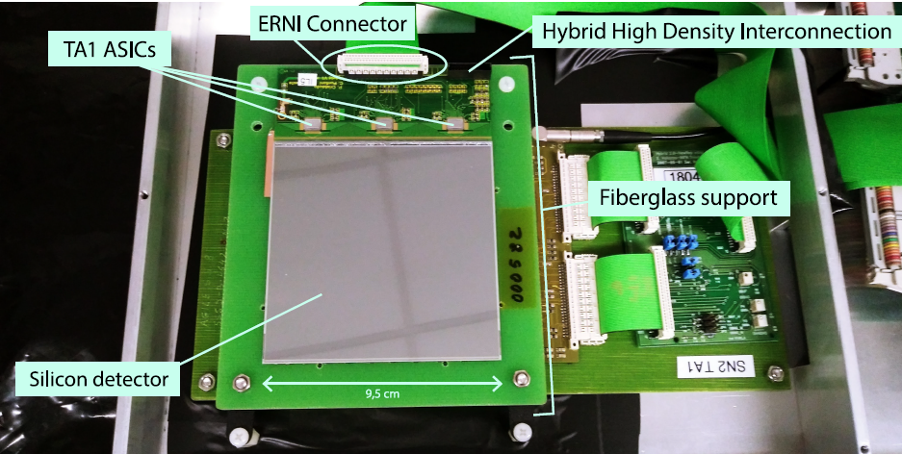
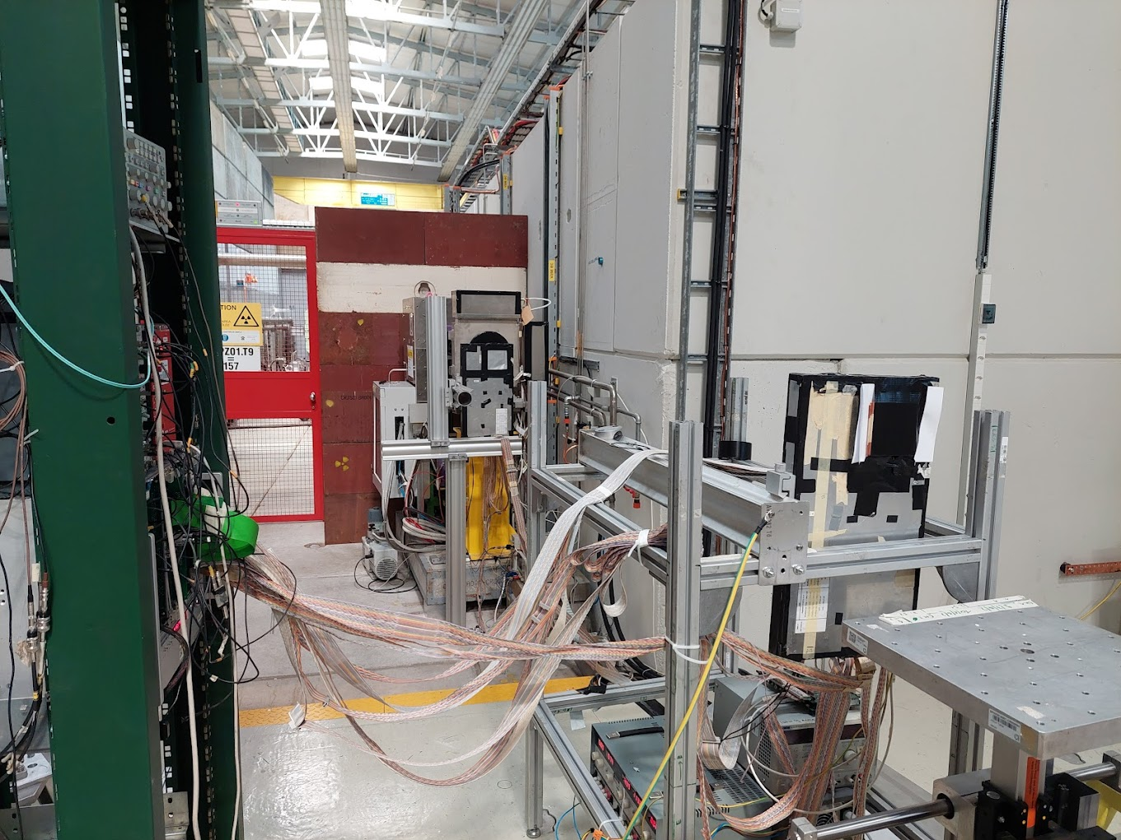
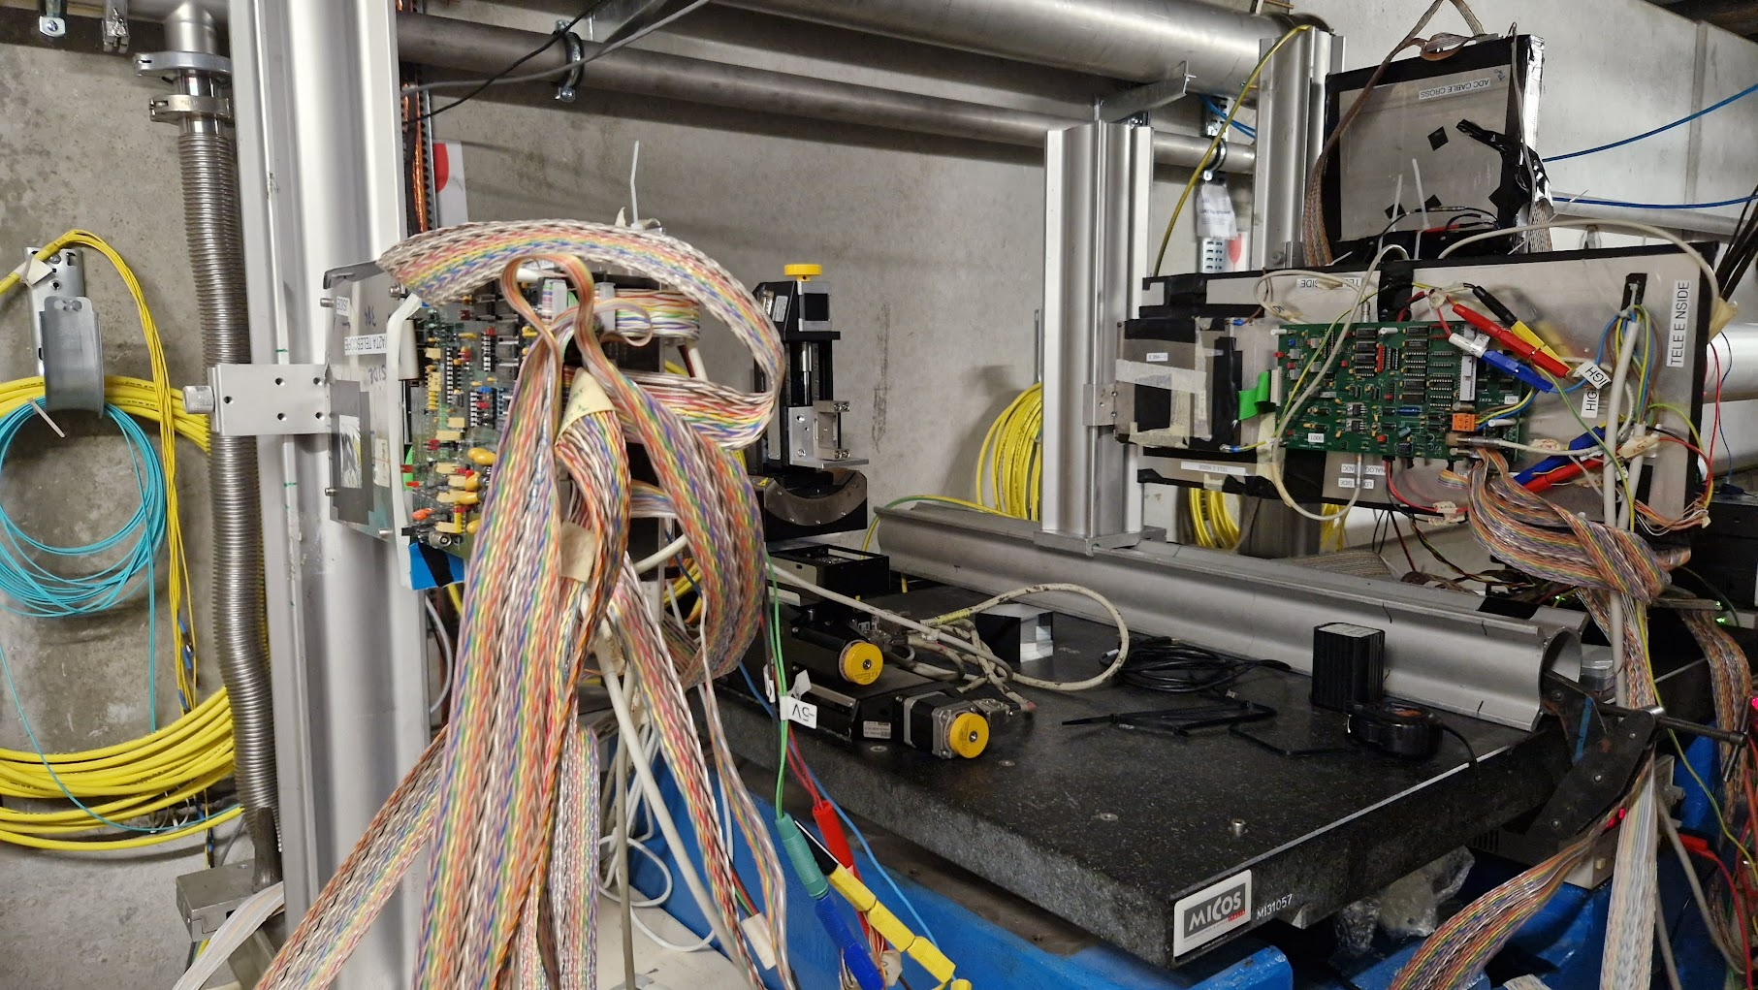
The INSULAB silicon tracking detectors
Each microstrip module can provide a single coordinate
→ Two modules in “XY” configuration
Beam Chambers:
9.5 x 9.5 cm²
242 µm pitch
Beam Telescopes:
1.92 x 1.92 cm²
50 µm pitch
10

Slide 11
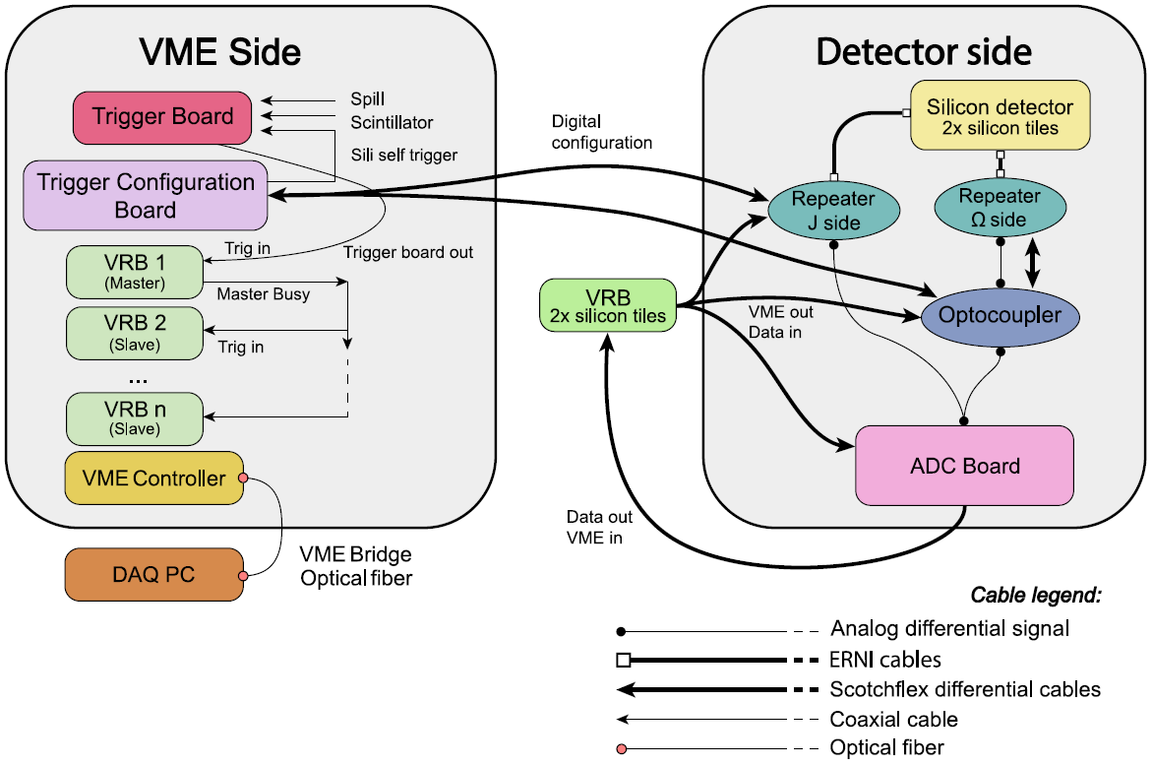
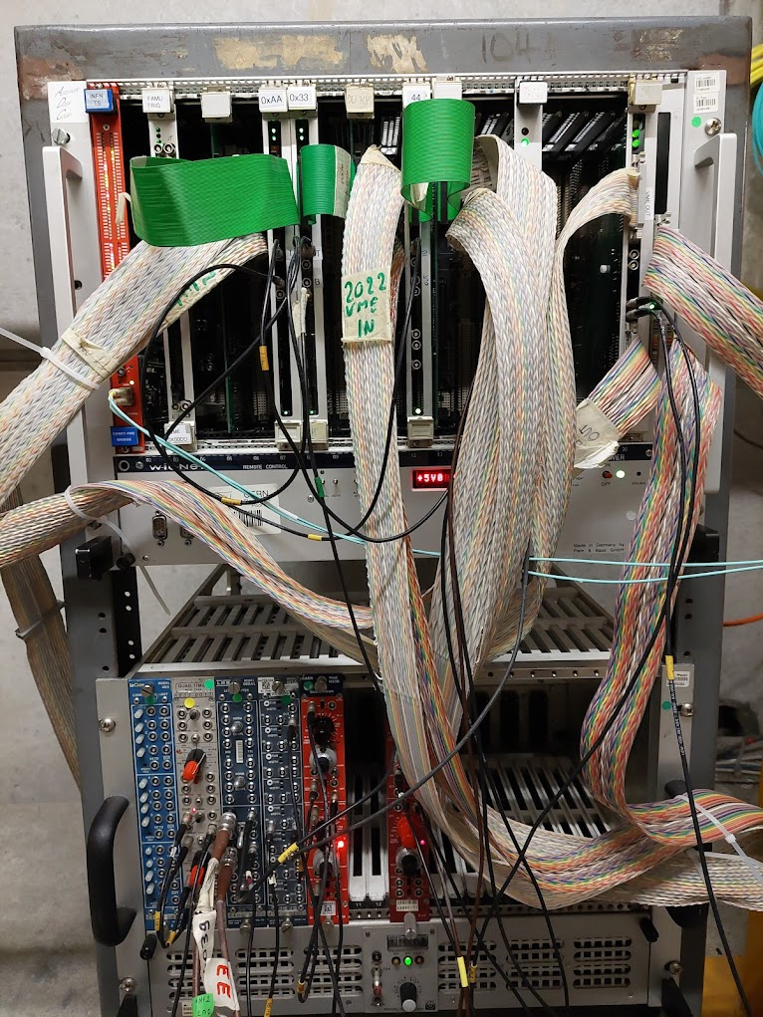
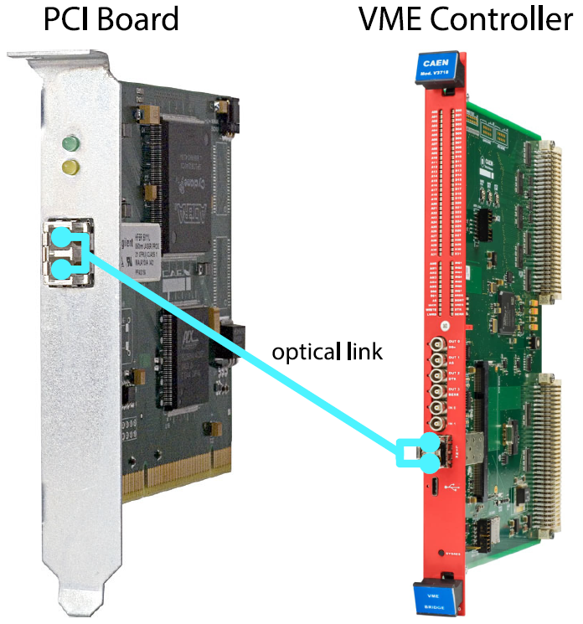
The readout electronics
Custom electronics boards
Used to read out the detectors and save the physical information on a PC
11

Slide 12
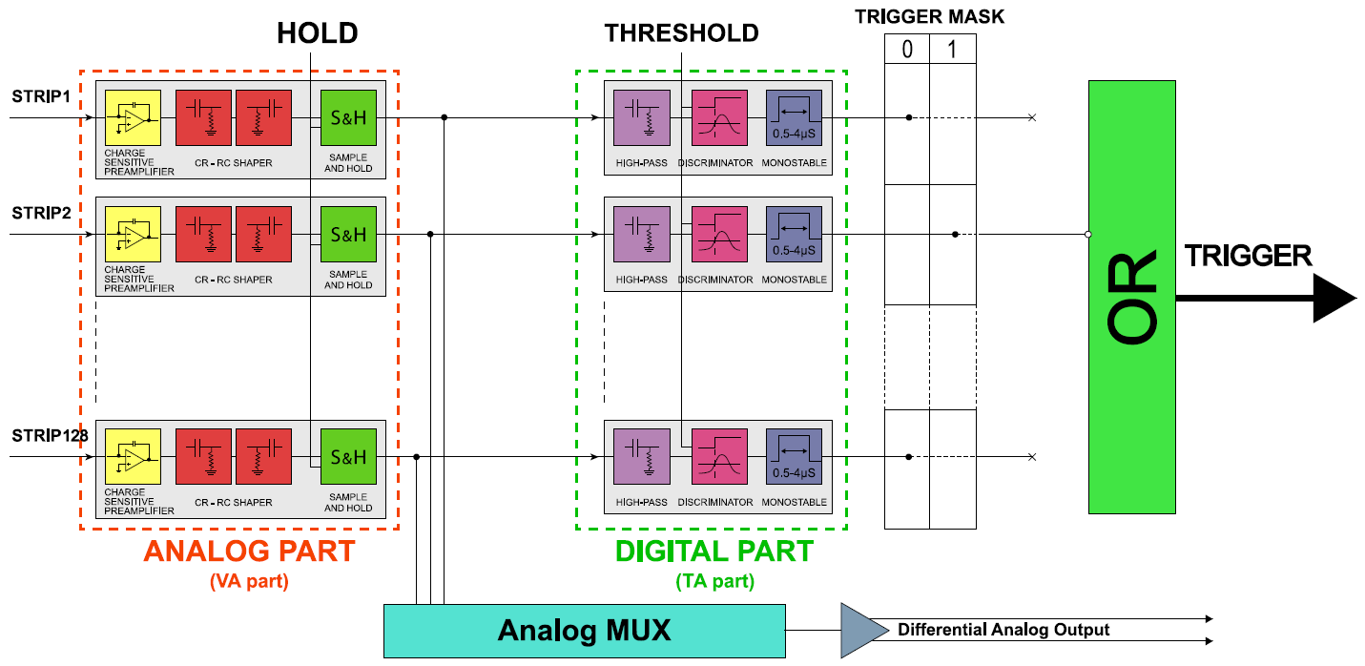
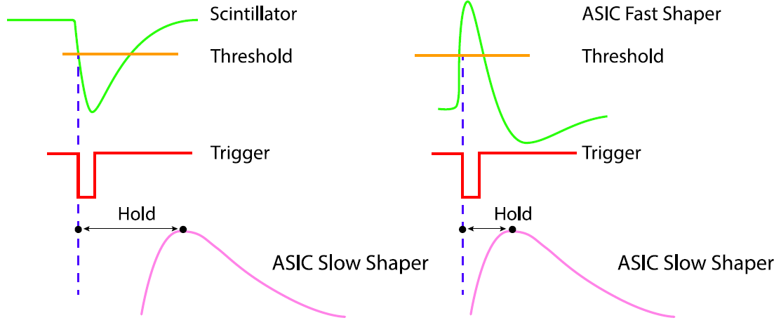
The ASICs
Application Specific Integrated Circuits
Analog part: integrates the deposited charge and samples the output signal at the peak
Digital part: generates a trigger signal when a charged particle crosses a given interval of strips
12

Slide 13
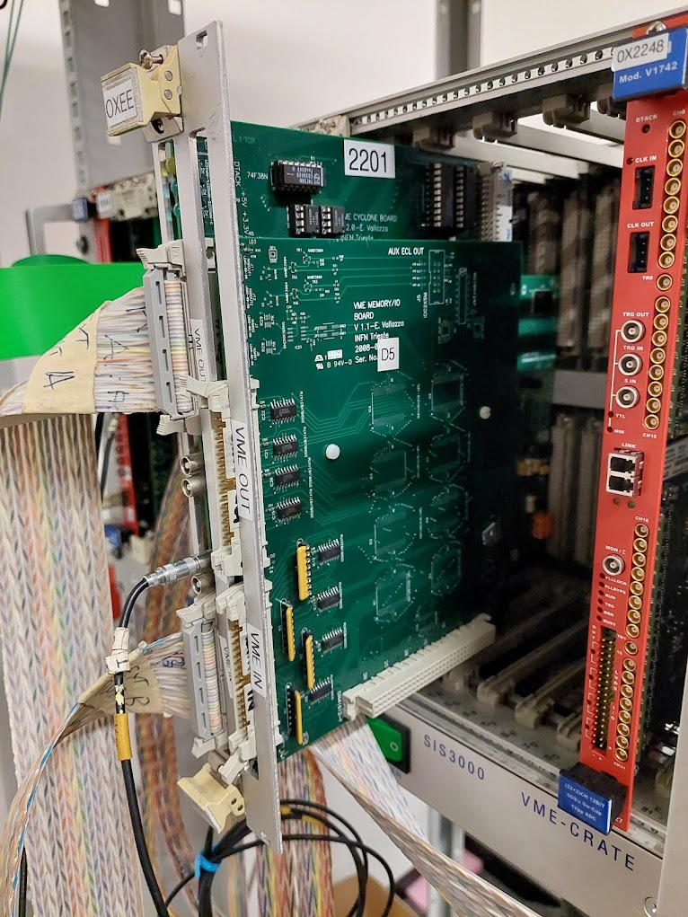
The Trigger Configuration Board
VME Board with a Field Programmable Gate Array (FPGA)
The firmware of the board was upgraded to:
  Load the Trigger Configuration Mask in a Shift Register, including the strips on which to trigger
  Load the trigger thresholds set by a DAC on the Repeater Board
  Receive the trigger signal from each silicon module
  Implement logic conditions on the signals of the detectors, such as the AND or the OR
The software was also upgraded to control this board
13

Slide 14
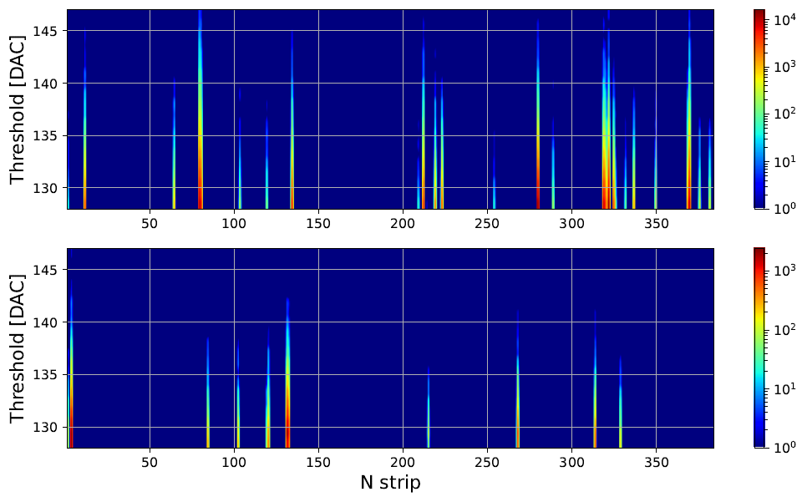
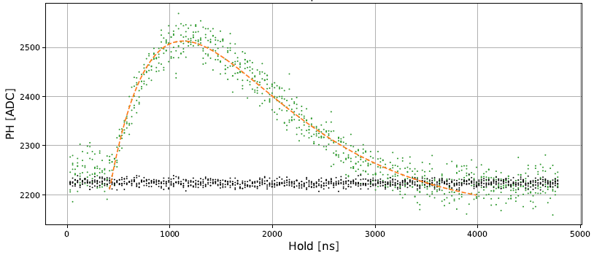

The ASICs Laboratory
Characterization (1)
Noise trigger rate as a function of the Threshold for each strip: by excluding the noisy strips, it is possible to choose a low threshold
Study of the analog response of each channel with an external calibration signal of different amplitudes
10 mV
14

Slide 15
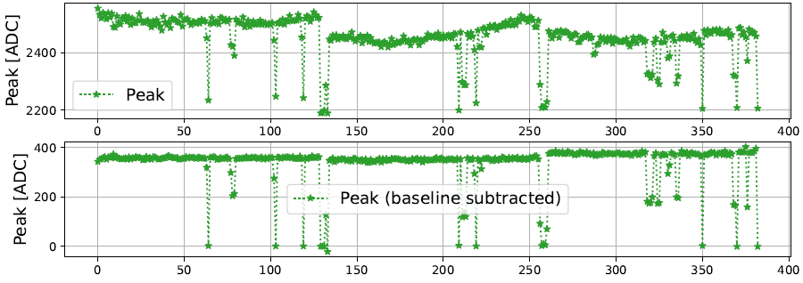
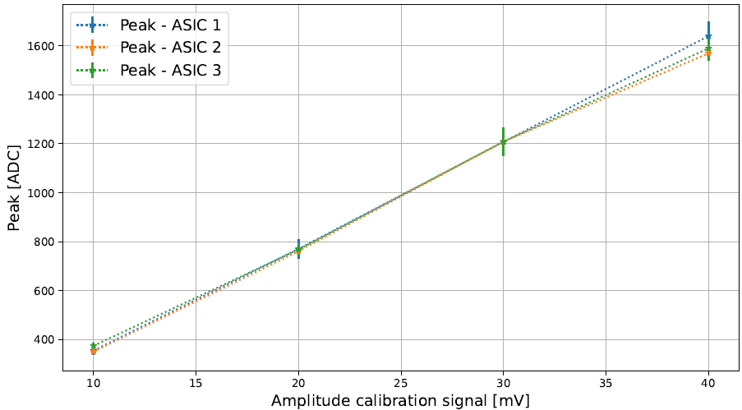
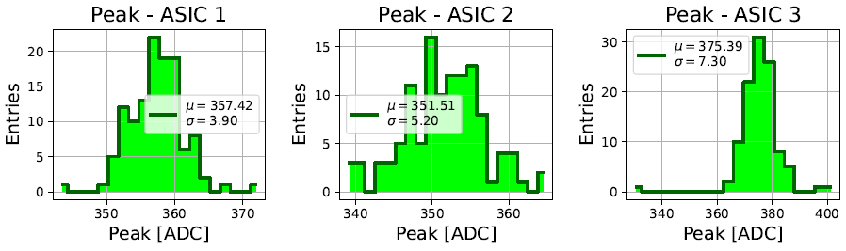
The ASICs Laboratory
Characterization (2)
3x ASIC
ASIC 1
ASIC 2
ASIC 3
Mean value of the peak distribution as a function of the amplitude of the calibration signal
10 mV
Saturation
15

Slide 16
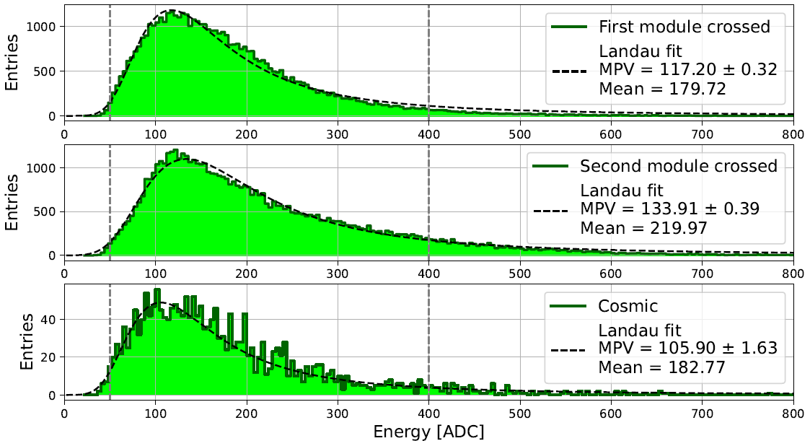
The ASICs Laboratory
Characterization (3)
⁹⁰Sr
X MODULE
Silicon
Detector
Y MODULE
e⁻
Study of the ASICs saturation in terms of MIPs → how many particles the detector can count
Cosmic rays: provide real MIPs
⁹⁰Sr: good approximation if placed directly over the module under study
Linear up to 1400 ADC → Linear for 8-13 MIPs
16

Slide 17
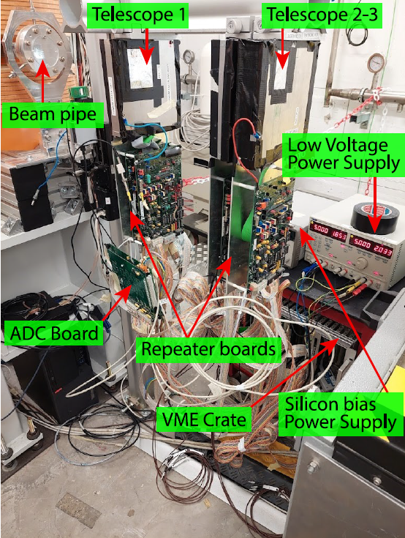
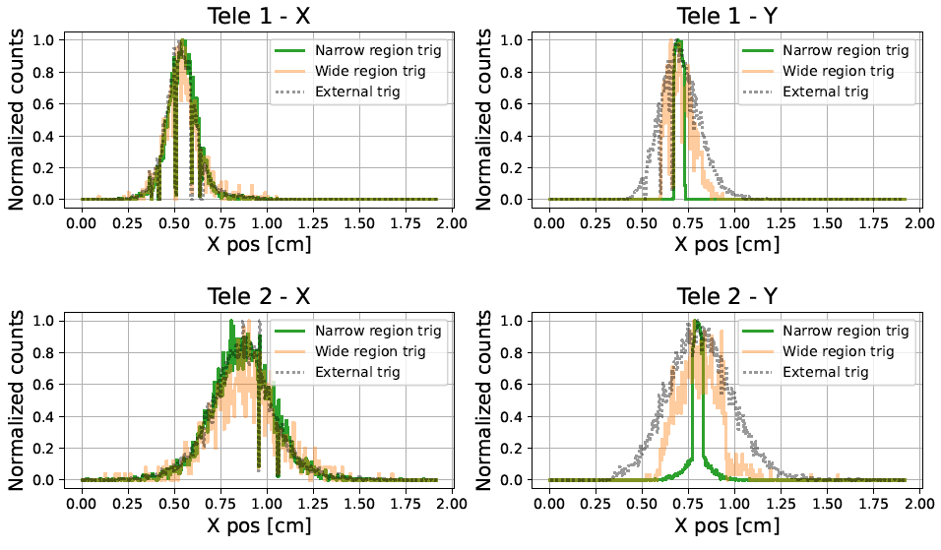
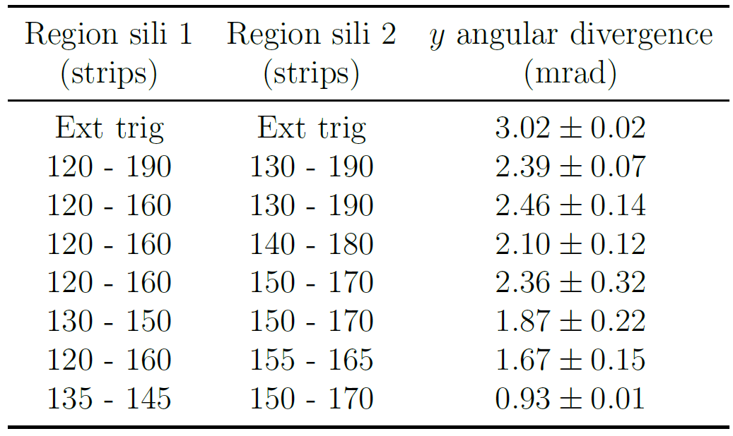
First on beam characterization
April 2023 @ BTF Frascati
First real test with a beam: reducing the trigger strip interval results in a reduction of the angular divergence
Trigger: AND of the Y
17

Slide 18
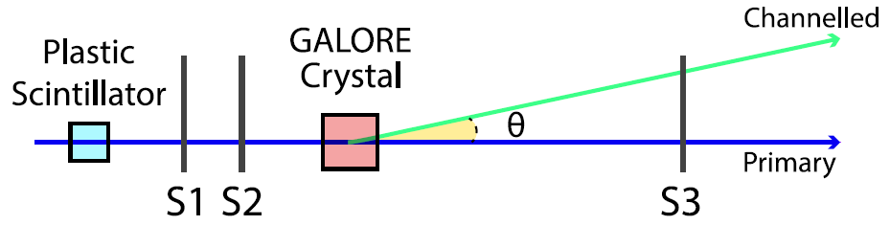
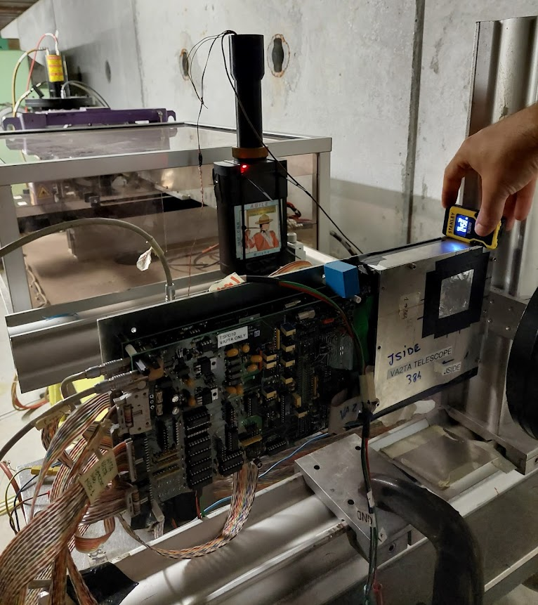
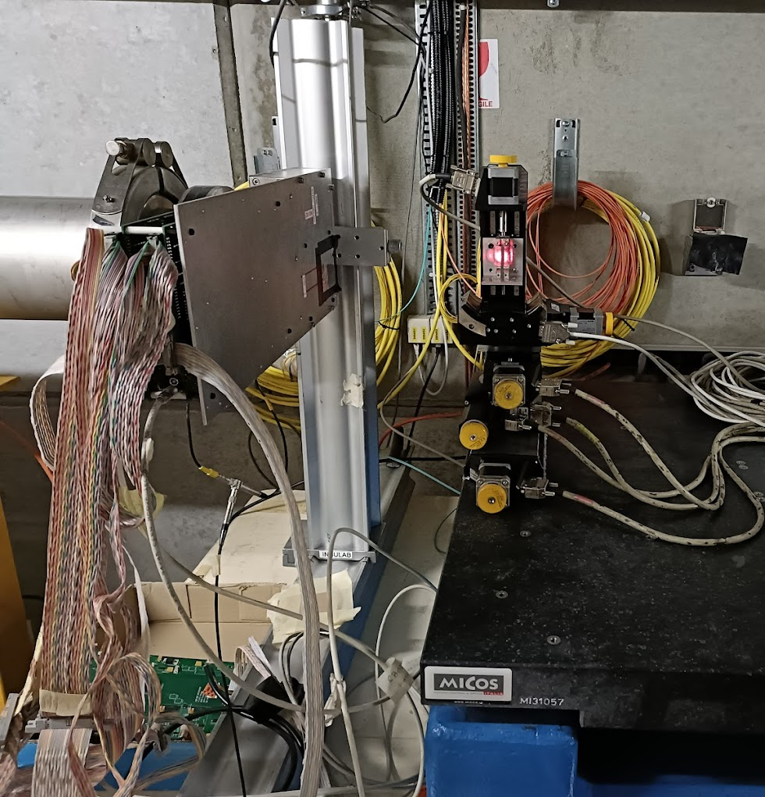
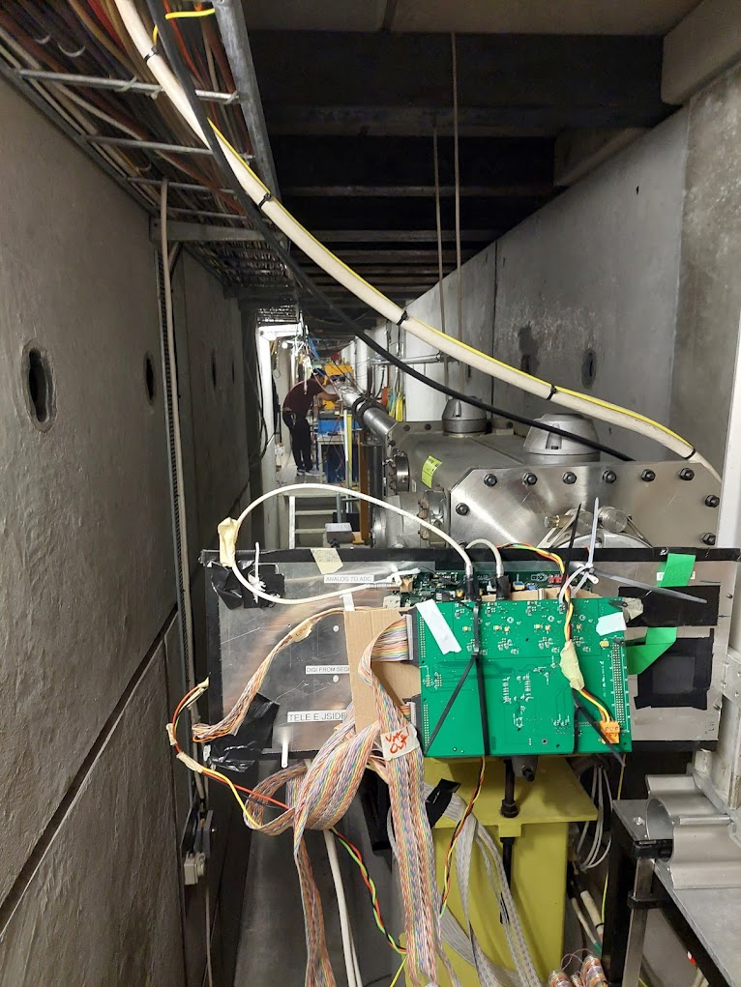
GALORE Beamtest
June 2023 @ H8
Sketch of the crystal in the XZ plane
BEAM
Test of the channelling efficiency
Need to track the incoming and outgoing particle
The downstream detector (S3) must “see” both the direct and the channelled beam
The H8 beam is ~1cm → Need to select only particles impinging on the crystal
18

Slide 19
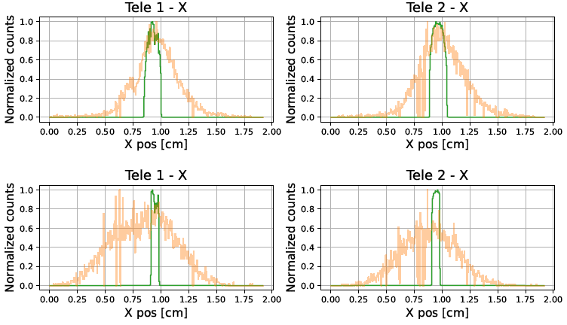
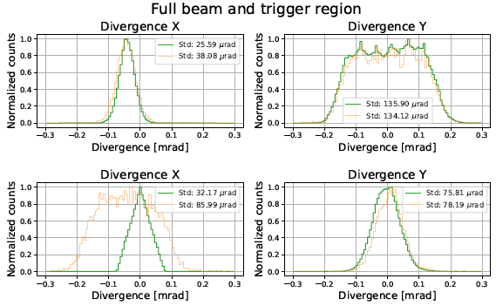
GALORE Beamtest (2)
Trigger interval
Reducing the trigger region allowed the collection of a large enough statistics
Without the self trigger upgrade, it would have been impossible to perform the beamtest
Select 3-5% of the whole beam
20-30 times faster
Trigger: AND of the X
Select 20-25% of the whole beam
4-5 times faster
19

Slide 20
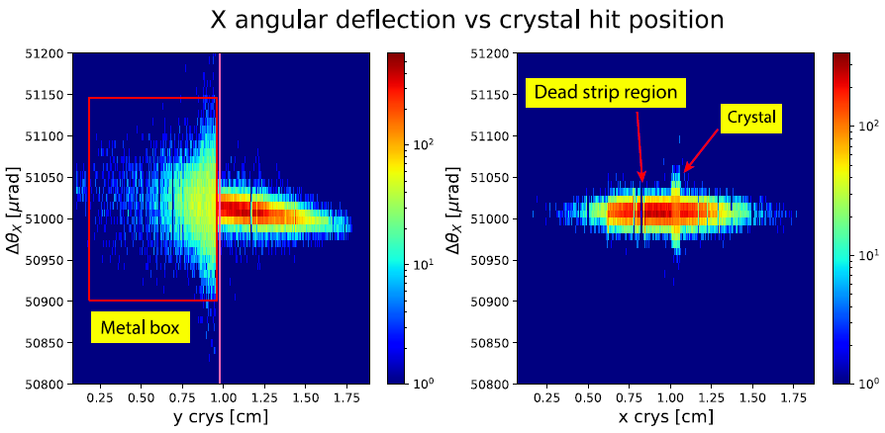
GALORE Beamtest (3)
Aligning the crystal
The crystal must be centered on the beam
Idea for alignment: particles scatter when they cross material, therefore the rms of the angular deflection distribution increases
20

Slide 21

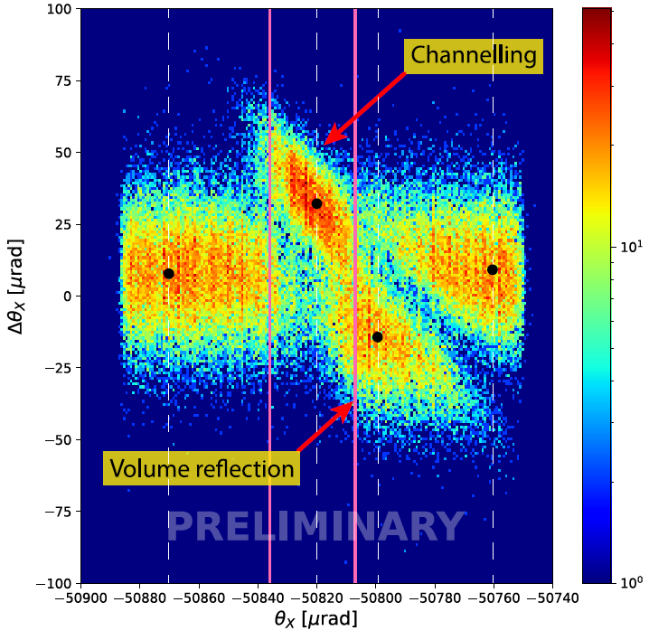
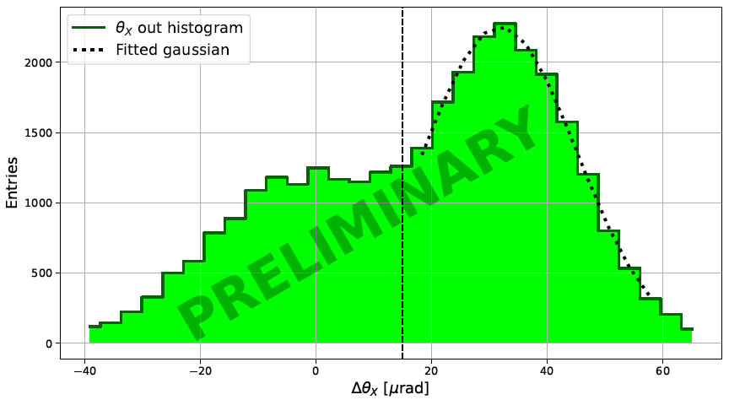
GALORE Beamtest (4)
Preliminary results
50 μm wide slice in the middle of the trench
Vertical slice ± one critical angle wide
Preliminary channelling efficiency: 65%
Can be caused by imperfections in the crystal lattice
21

Slide 22
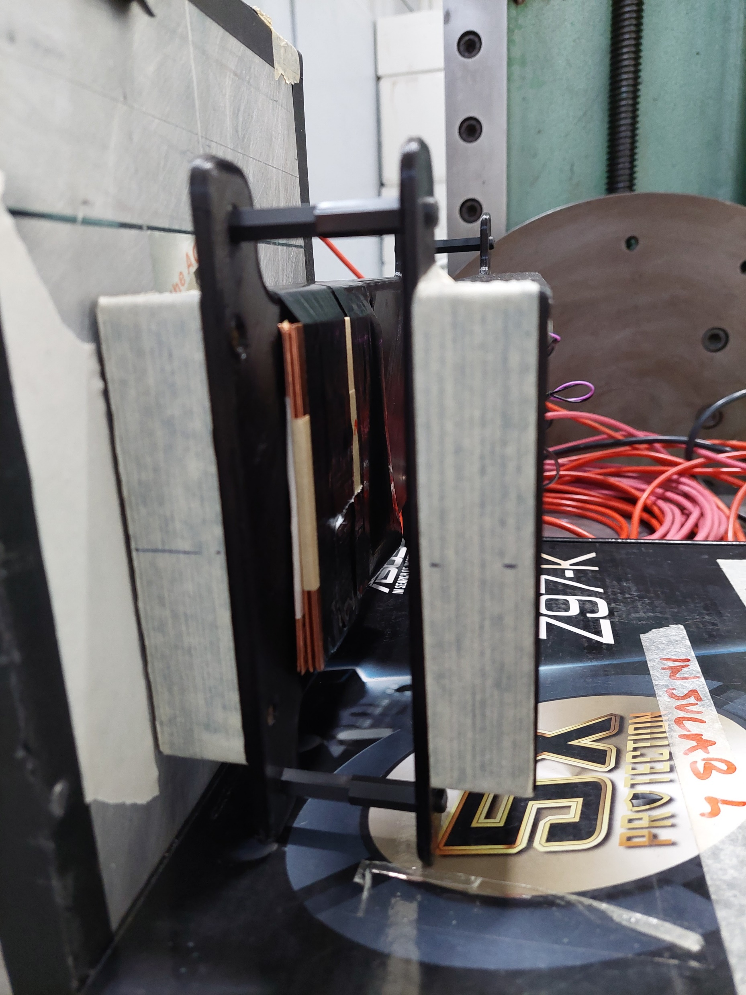
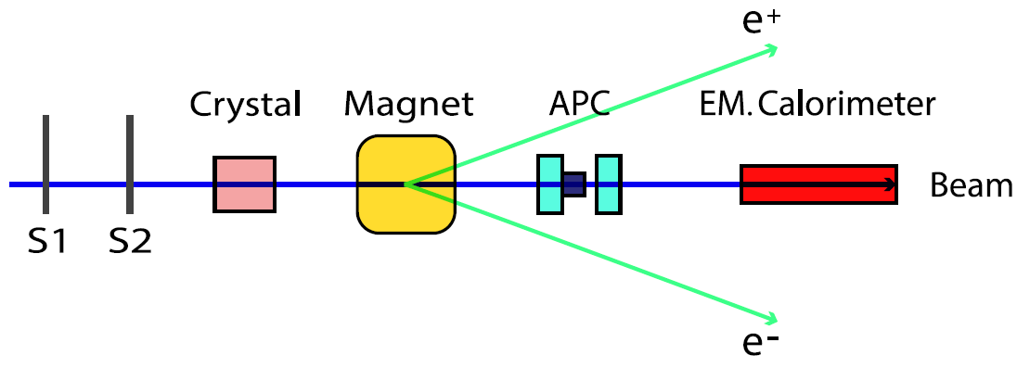
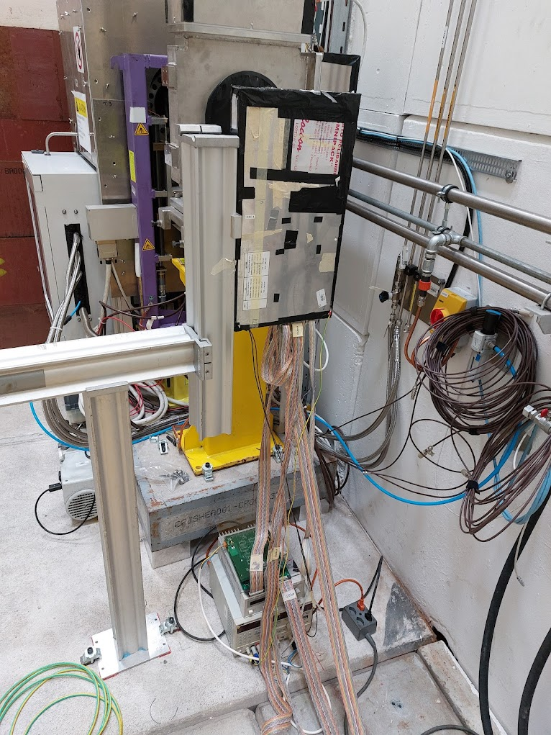
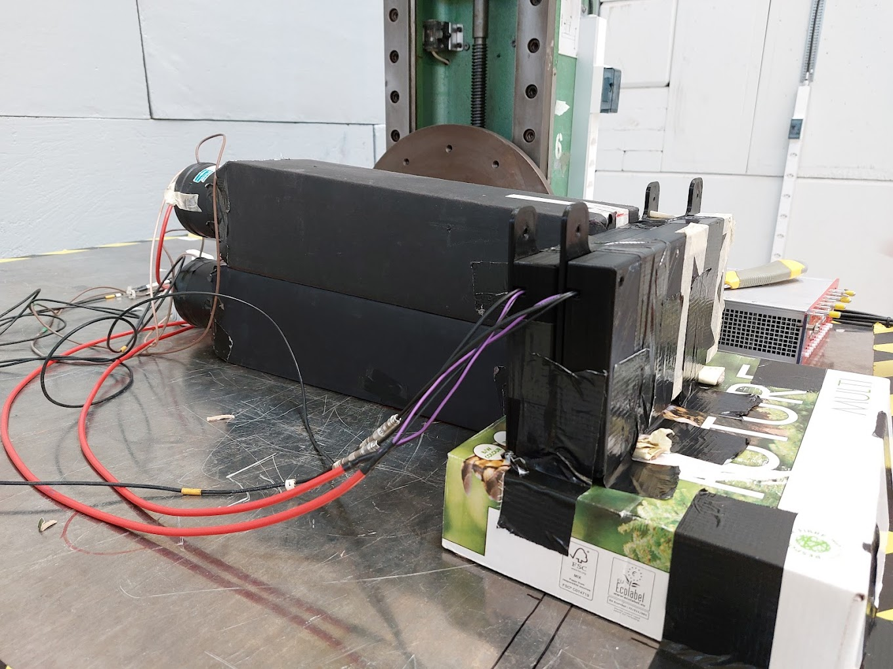
e+BOOST Beamtest
August 2023 @ T9
Active Photon Converter:
Provides average information about the multiplicity of the photons
Scinti
Cu
EM Calo
APC
22

Slide 23

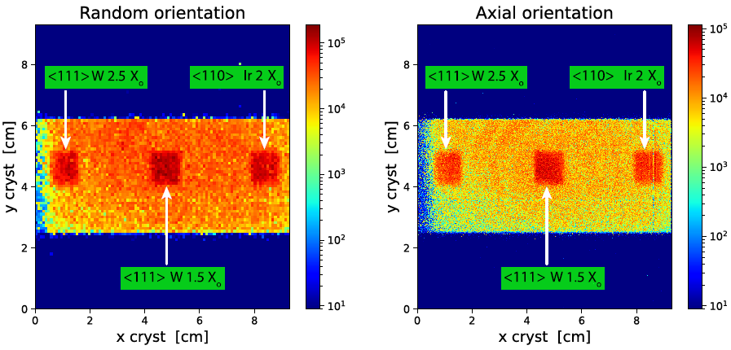
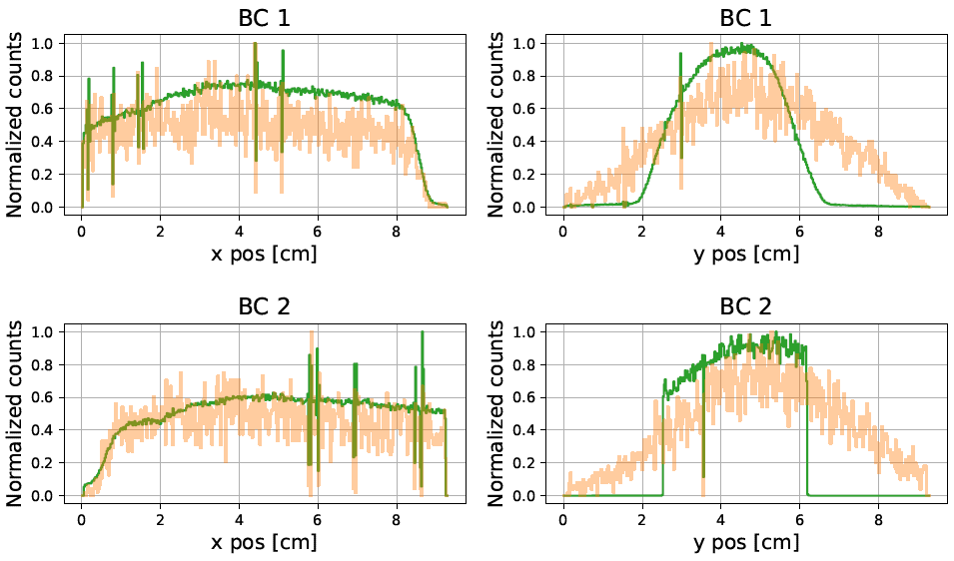
e+BOOST Beamtest (2)
Aligning the crystal
Easy task with respect to the GALORE crystal
A direct effect of the interaction between the beam and the crystal can be measured, namely the produced radiation
However, a very large statistics is required with a wide beam
Triggering on a 3cm wide vertical region allowed to acquire all the three crystals together
23

Slide 24
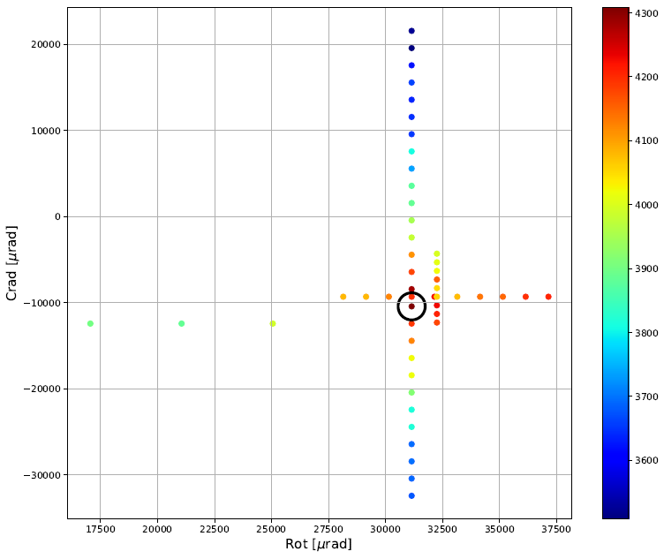
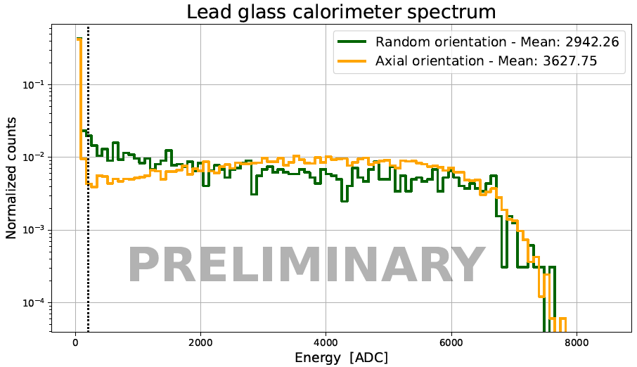
e+BOOST Beamtest (3)
Preliminary results
Axial: +23%
radiation production
For <111> W 1.5 X₀
θ_{yz}
θ_{xz}
Stereogram for orienting the crystal in the axial direction
Energy deposited in the calorimeter for non oriented and axial orientation
24

Slide 25
Conclusions & outlooks
The tracking system was upgraded to allow the silicon microstrip detectors to self generate a trigger signal when a charged particle crosses a given strip interval → Beam size and angular divergence reduced selecting a portion of the beam to match the experimental requirements of GALORE and e+BOOST
The upgraded test system proved to work properly, for both the experiments, allowing the collection of a statistics large enough in a short time
During the GALORE beamtest, statistics was acquired 20-30 times faster
For the crystal-based hybrid positron source beamtests, different crystal radiators have been tested, and the relative increment in the produced radiation have been measured
The system is versatile: in the future it can be applied to any kind of beamtest where a high-resolution particle tracking is needed, with the possibility to select a small portion of the beam thus reducing also the divergence, which is a fundamental parameter when studying oriented crystals
25

Slide 26
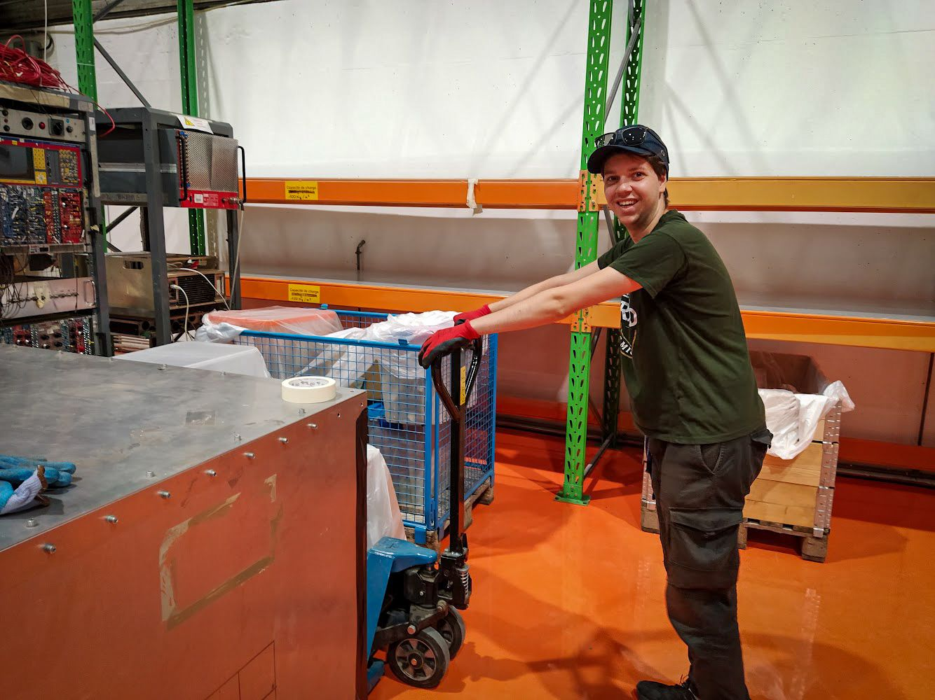
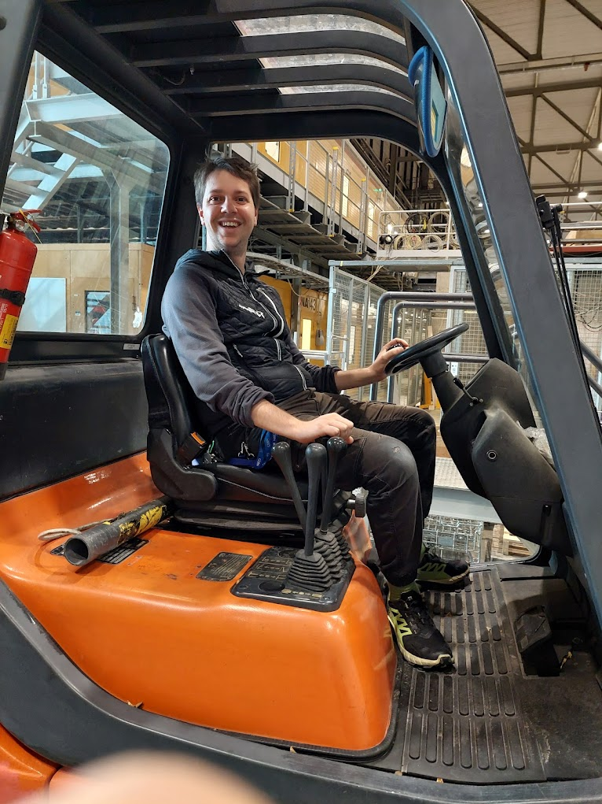
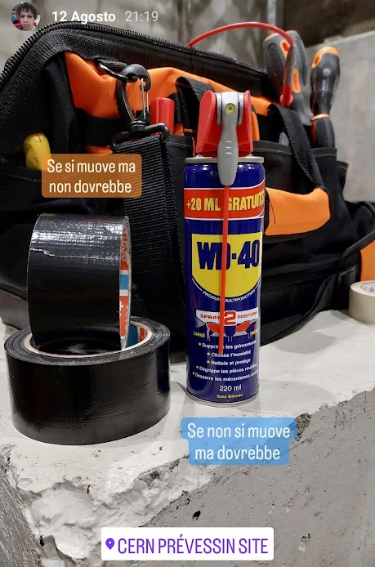









Thanks for your attention
26

Slide 27
Backup slides
27

Slide 28


Miller indices
28

Slide 29
What are bent crystal already used for?
Few mm of crystals can act as hundreds of Tesla magnets:
Beam collimation
Extracted beamlines
Physics Beyond Standard Models: the magnetic moment of short-lived charmed baryons can be measured from the magnetic moment precession induced inside a bent crystal
29

Slide 30


Multi-stage high-precision goniometer
30

Slide 31
CERN Beamlines
31

Slide 32



Main features of the ASICs
32

Slide 33


VA1TA Problematic channels
33

Slide 34





VA2TA Lab Characterization
34

Slide 35

GALORE strange regions
35

Slide 36


GALORE Beamtest
Performance of the detectors
Pull: ratio between the PH of the channel with the maximum signal and its corresponding noise rms
Eta: describes the symmetry in the sharing of the charge between nearby strips. Different shapes for single and double side detectors
36

Slide 37

Bethe-Bloch
37

